Slide 1
Modeling Invasive Carp Passage Risk in the Mississippi River
Caleb Bush 4/28/26

Slide 2
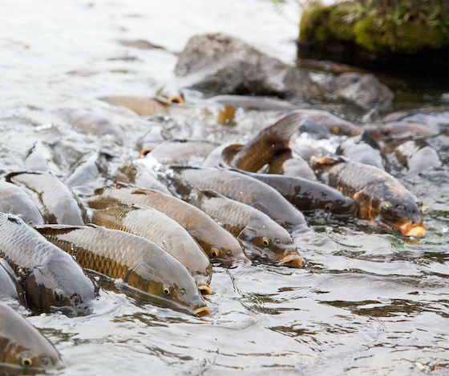
Project Background
Invasive Carp have Invasive Asian Carp have become a major threat to the Mississippi River by competing with native fish and damaging their habitat.
This project would use data collected through acoustic telemetry to analyze and predict invasive carp movements in R.

Slide 3
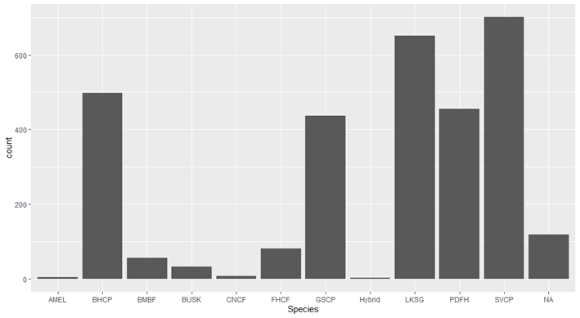
About the Dataset
Data is from the U.S Geological Survey
Collection occurred from Lock and Dam 19 in Iowa
Gathered data from transmitters in tagged fish
Multiple fish species other than carp in the dataset

Slide 4
Look into the Data
33 Original Variables
3043 Rows
Not too many missing values
Had multiple unnecessary variables

Slide 5
Date Preparation
Converting Date column to date objects
Removing columns that have no impact on prediction with high missing values
Getting rid of columns that say the same thing as another column
Converting categorical variables to factors
Log transform important columns with big outliers

Slide 6
Models Used in R for this Project
Random Forest:
Uses many decision trees to combine for a final prediction
Helps improve stability and reduces overfitting
Gradient Boosting:
Builds decision trees sequentially to correct mistakes from the previous one
Is useful for capturing subtle triggers
K Nearest Neighbors:
Predicts outcomes by finding the most similar data points

Slide 7
Random Forest Setup
Library used: randomForest
Filter to only invasive carp species
Get unique ids as not every entry is unique with transmitterid
70/30 split
Apply custom threshold for predictions

Slide 8
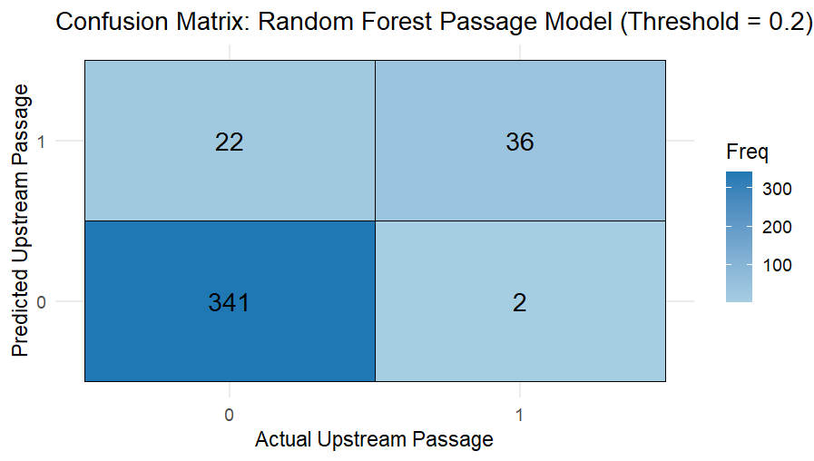
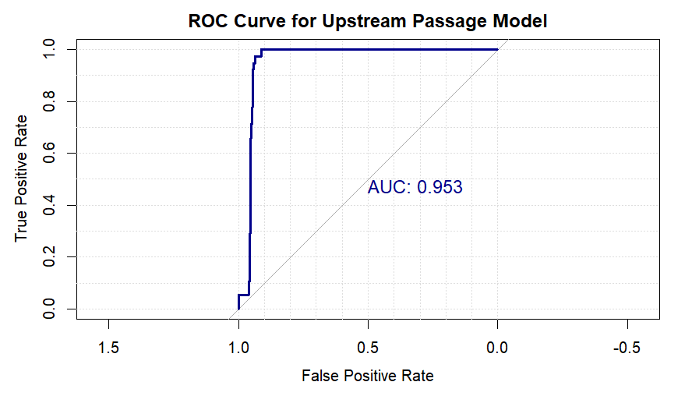
Random Forest Output
Accuracy: 0.94
Precision: 0.621
Recall: 0.94.7
F1: 0.75

Slide 9
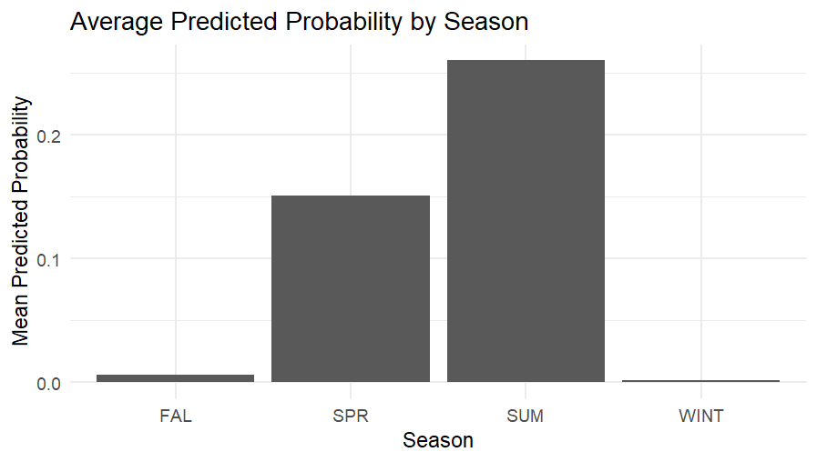
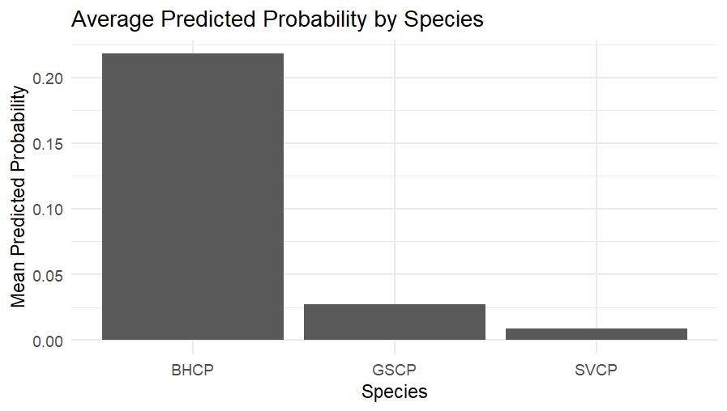
Random Forest Conclusions
The model now performs well at identifying minority events
The trade-off is a reduction in precision, meaning more false positives are introduced
The data still contains very few upstream occurrences, which makes classification inherently imbalanced
The model is best at predicting when passage doesn’t occur

Slide 10
Gradient Boosting Setup
Library used: xgboost
Convert response variable to 0/1
Remove irrelevant variables
Filter for invasive species
Create model matrix
70/30 split
Handle class imbalance
Convert data into Dmatrix
Use 0.25 threshold for predictions

Slide 11
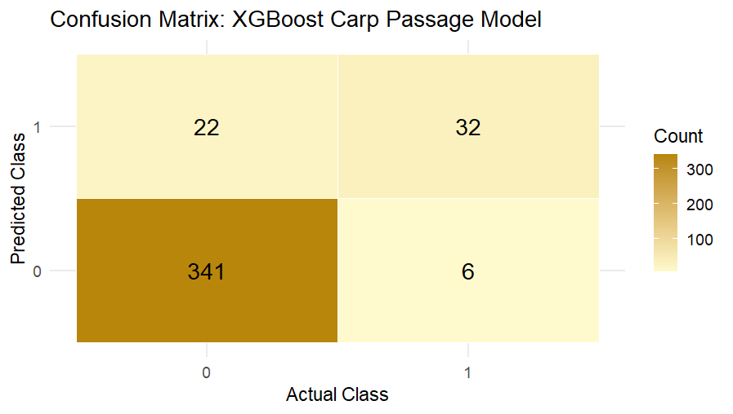
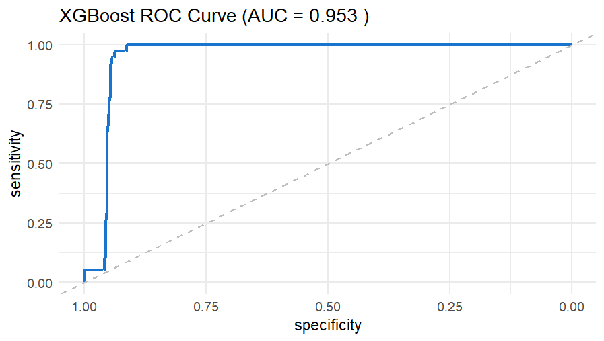
Gradient Boosting Output
Accuracy: 0.93
Sensitivity: 0.84
Specificity: 0.94
Kappa: 0.6576
Correct Classification: 0.89

Slide 12
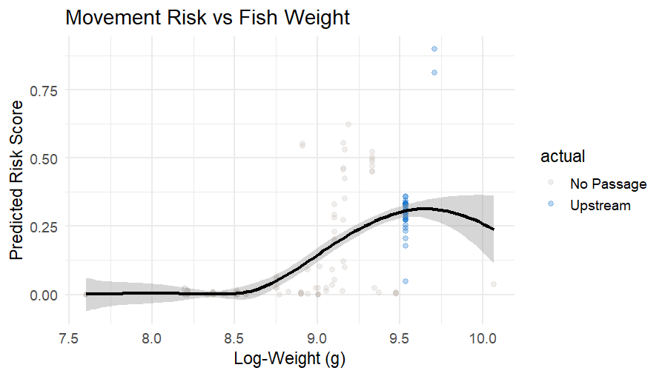
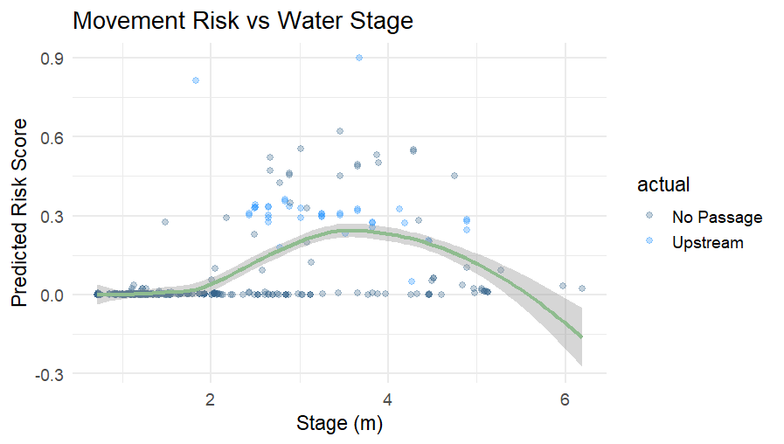
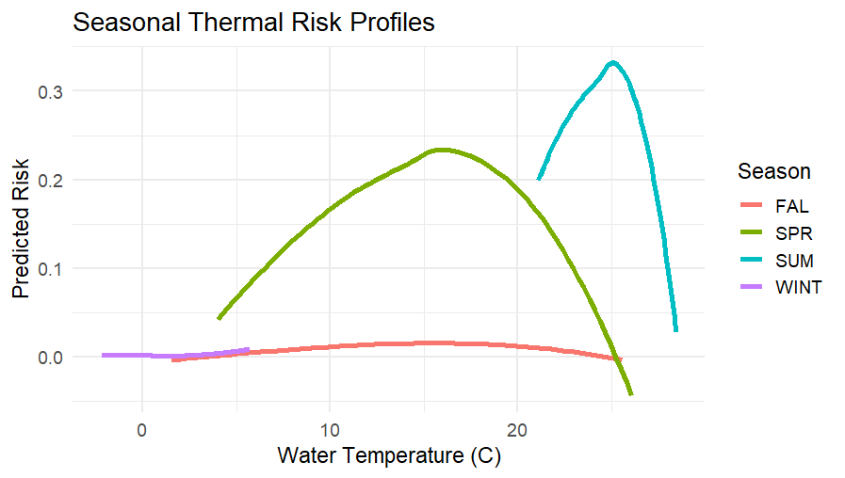
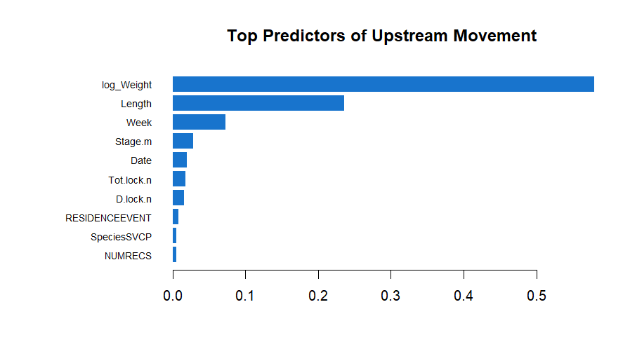
Gradient Boosting Output

Slide 13
Gradient Boosting Conclusions
Strong ability to distinguish between movers and non-movers
The model shows that upstream passage is mainly reliant upon physical features
It’s not just temperature that causes them to move but rather the spring and summer specifically
Certain windows of river-height are the majority of upstream passage

Slide 14
K Nearest Neighbors Setup
The caret package was the main library used for this model
This model used the same train/test split as previous model
A custom threshold of 0.25 was also used
Cross validation method in the model

Slide 15
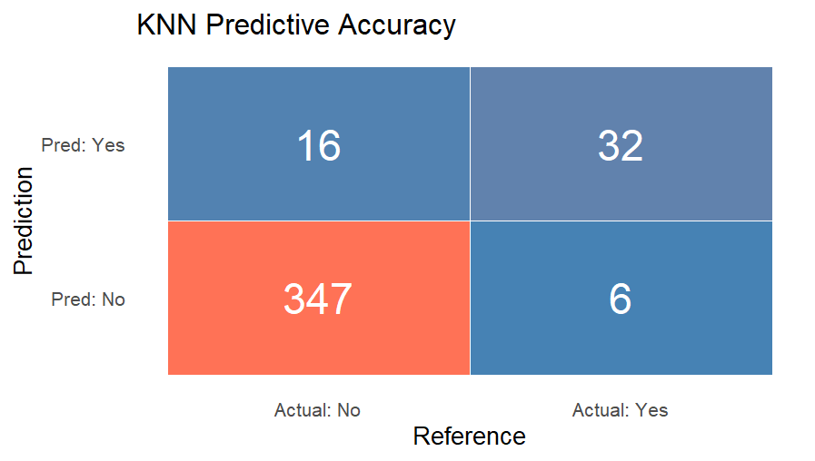
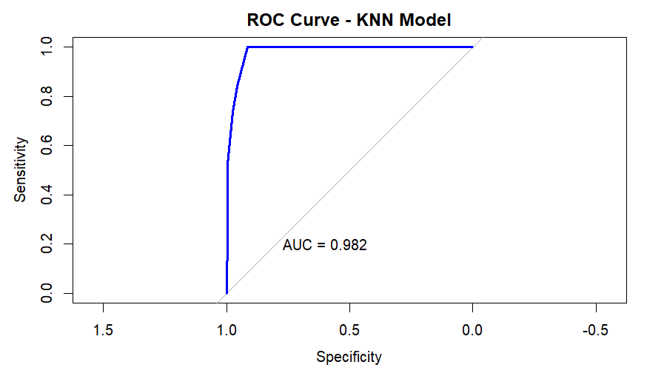
K Nearest Neighbors Output
Accuracy: 0.9451
Kappa: 0.7139
Sensitivity: 0.84
Specificity: 0.956

Slide 16
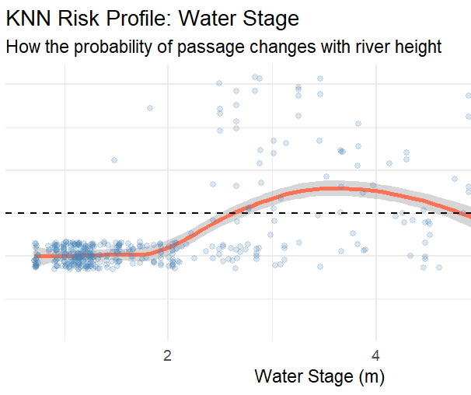
K Nearest Neighbors Conclusions
Most accurate model overall
Water level risk threshold is 2.5m
Risk goes back down after 5m
High negative predictive value of .983
means that model is very good
at predicting no movement risk

Slide 17
Final Insights
All three models had consistent results meaning that the driver are carp movement are highly predictable
The invasive carp move upstream between 2.5m-5m, and their peak movement is at 3.8m
Biological factors such a weight and length were consistently the top predictors
Movement is not triggered by temperature alone but by the intersection of temperature and season. The highest risk occurs during the Spring and Summer from 15°C-25 °C

Slide 18
Sources
R Core Team (2025). R: A Language and Environment for Statistical Computing. R Foundation for Statistical Computing, Vienna, Austria.
RStudio Team (2025). RStudio: Integrated Development Environment for R. Posit Software, PBC, Boston, MA.
Fritts, A., & Knights, B. (2020, November 30). 2017-2018 telemetry data for Asian carp and native fish species at lock and dam 19 in the upper mississippi river basin. sciencebase.gov.
https://www.sciencebase.gov/catalog/file/get/5fbe7c1ad34e4b9faad7e8cc?f=__disk__14%2F2a%2F6b%2F142a6bfa9ab133230a0c0a6e45f2b278541dde1c&transform=1&allowOpen=true
Robin, X., Turck, N., Hainard, A., Tiberti, N., Lisacek, F., Sanchez, J.-C., & Müller, M. (Year). pROC: Display and analyze ROC curves (R packageversion X.X.X). CRAN. https://cran.r-project.org/web/packages/pROC/pROC.pdf
Görög, L. (2022, September 5). R packages for Predictive Analytics. Predictea Digital Care - AI Strategy, Predictions, Data Analysis.
https://www.predictea.com/r-packages-for-predictive-analytics/
https://xgboost.readthedocs.io/en/release_1.5.0/R-package/xgboostPresentation.html
https://www.datacamp.com/tutorial/k-nearest-neighbors-knn-classification-with-r-tutorial

